Slide 1
Office 365 Development

Slide 2


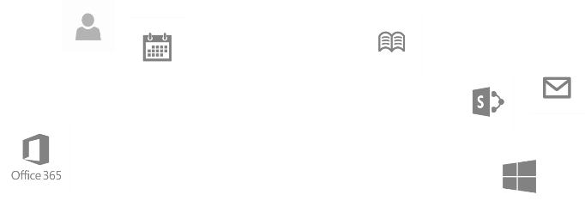
Recap
Introduction to Office 365 development
Module 1: Introduction to Office 365 development
Module 2: Getting started with Apps for Office
Module 3: Getting started with Apps for SharePoint
Module 4: Moving Full Trust Code to the Cloud Using Repeatable Patterns and Best Practices
Module 5: Getting started with the Office 365 APIs
dev.office.com/training

Slide 3
Course Agenda
Deep Dive into Integrating Office 365 APIs with Web Applications
Module 1: Deep Dive into Azure AD with the Office 365 APIs
Module 2: Deep Dive into Office 365 APIs for Calendar, Mail, and Contacts
Module 3: Deep Dive into Office 365 APIs for OneDrive for Business
Module 4: Deep Dive into Office 365 APIs for SharePoint Site services
Module 5: Deep Dive into Office 365 APIs for Yammer services
Module 6: Deep Dive into Office 365 APIs for Office Graph
Module 7: Deep Dive into Office 365 APIs for OneNote services

Slide 4
Deep Dive into Office 365 APIs for Calendar, Mail, and Contacts

Slide 5

Agenda
Overview
Connected Services
Paging Support
CRUD Support
Exchange Operations using REST

Slide 6
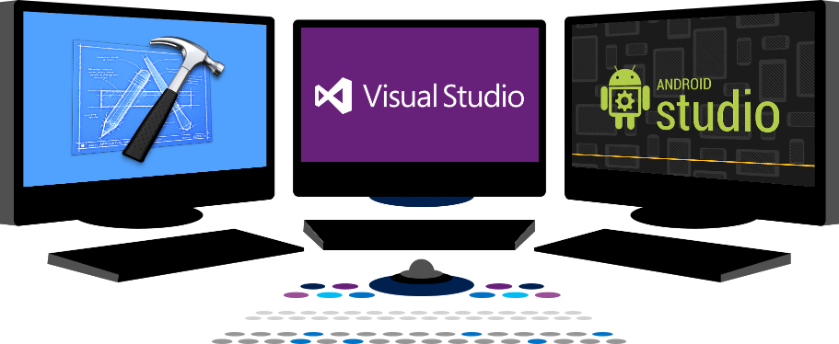














Vision
EXTEND OFFICE EVERYWHERE
CONNECT TO OFFICE 365 SERVICES
BUILD USING AN OPEN PLATFORM
Delve
z
Users and groups
Files
Mail
Calendar
My Apps
Video Portal
Contacts
Office Graph
Presentations
Documents
Spreadsheets
Lync
OneNote
Yammer

Slide 7
Overview

Slide 8
Office 365 APIs for Calendar, Mail and Contacts
Office 365 APIs
Mail Message API
Calendar Events API
Contacts API
Office 365 APIs accessible through REST
https://outlook.office365.com/api/v1.0/me/messages
https://outlook.office365.com/api/v1.0/me/events
https://outlook.office365.com/api/v1.0/me/contacts
Office 365 APIs accessible through OutlookServicesClient
A library which abstracts away sending and receiving REST request

Slide 9
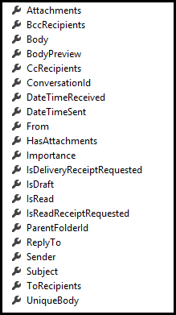
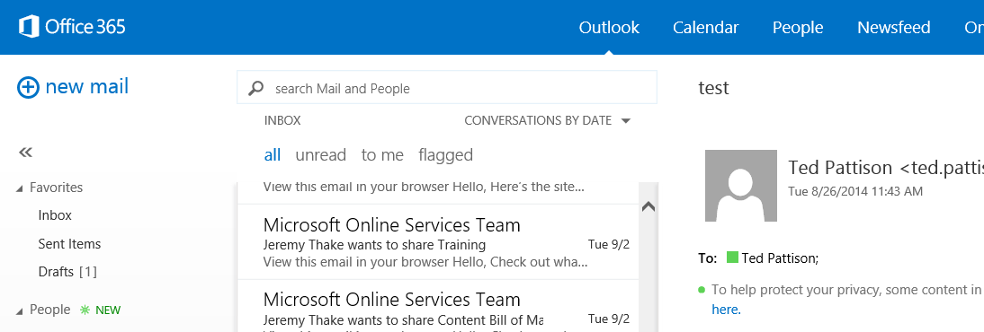
Mail Messages
Message
Common API operations
Reading messages
Deleting messages
Sending messages
Working with attachments

Slide 10
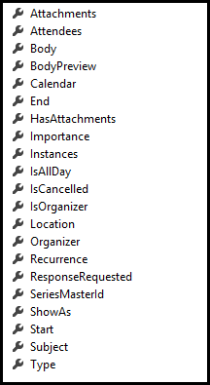
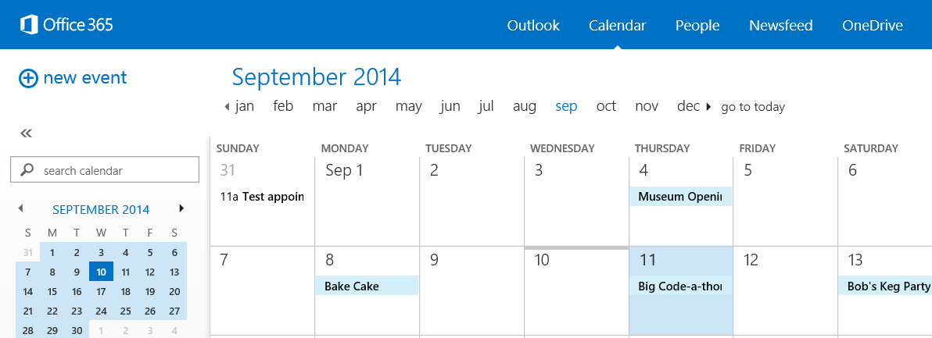
Calendar Events
Common API operations
Reading events for specific date range
Creating events
Deleting events
Editing events
Event

Slide 11
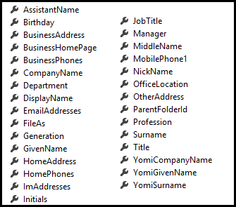
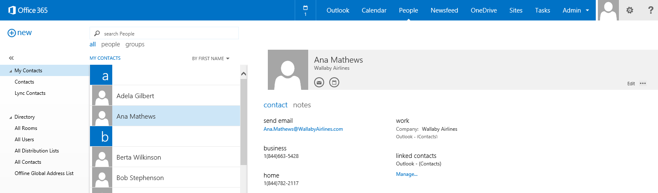
Contacts
Common API operations
Reading contacts
Searching for contacts
Creating contacts
Deleting contacts
Editing events
Contact

Slide 12
Connected Services

Slide 13
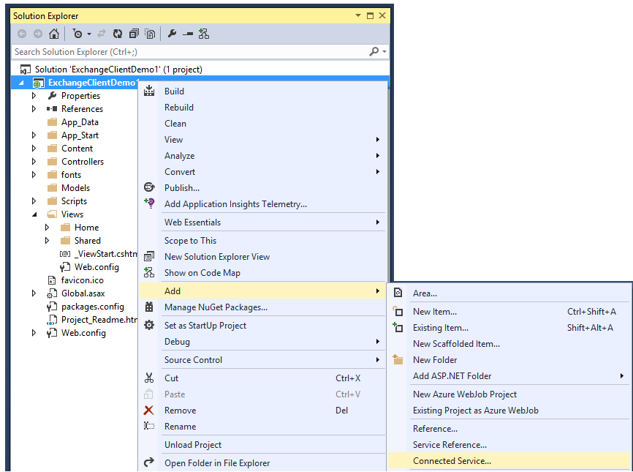
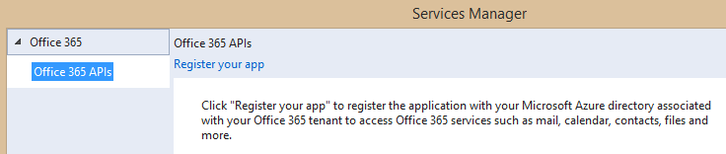
Adding Connected Services
1
Project > Add > Connected Service…
2
Register your app

Slide 14
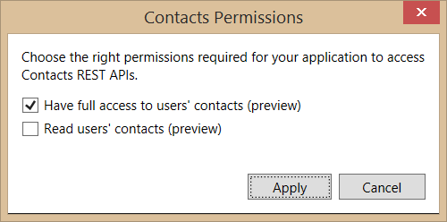
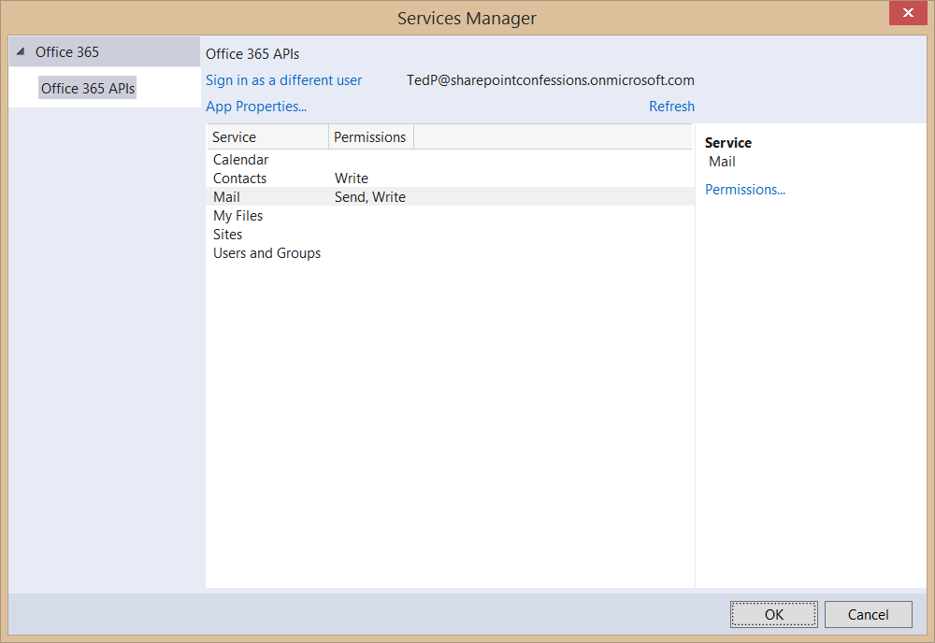
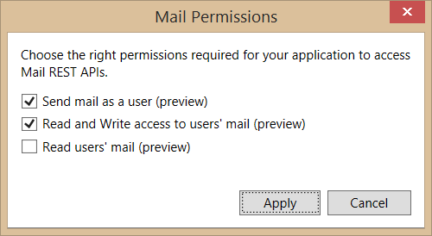
Connected Services Permissions
3
Select required app permissions

Slide 15
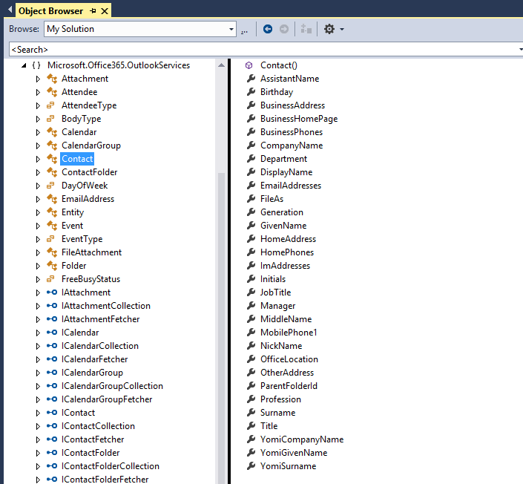
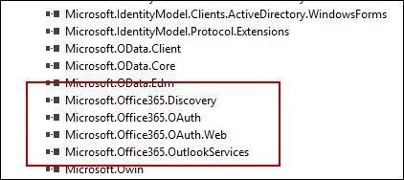
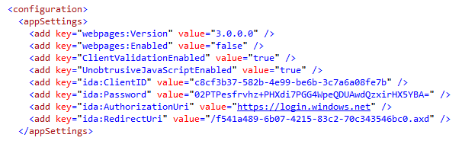
Projects with Connected Services
Assemblies added with a Connected Service
Microsoft.Office365.OAuth
Microsoft.Office365.Oauth.Web
Microsoft.Office365.Exchange
AppSettings added with a Connected Service

Slide 16
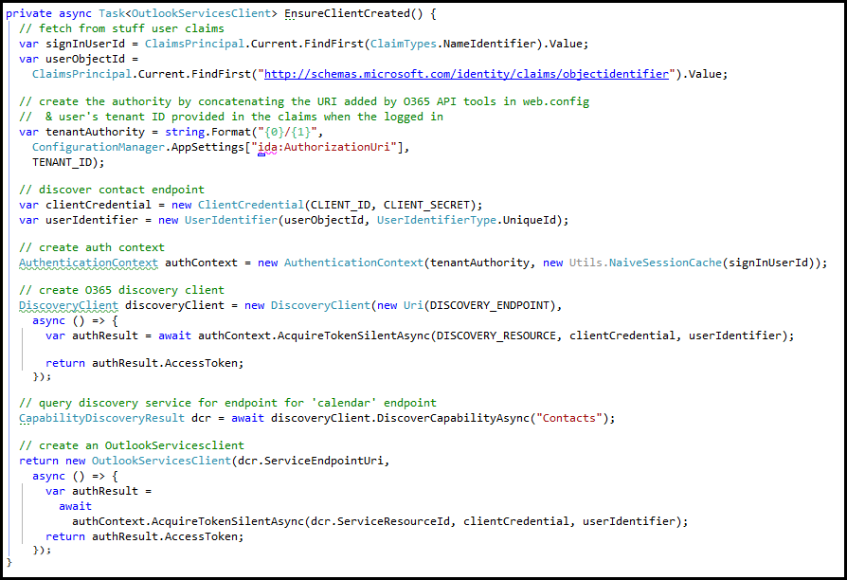
Retrieve access token using AcquireTokenSlientAsync

Slide 17
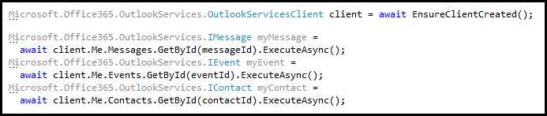
Programming with OutlookServiceClient
OutlookServiceClient provide Me property
Provides access to mail, events and contacts of currently logged in user
Explicit calls used (e.g. ExecuteAsync) to call across network to Office 365 service

Slide 18
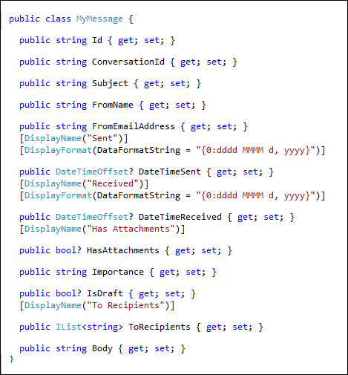
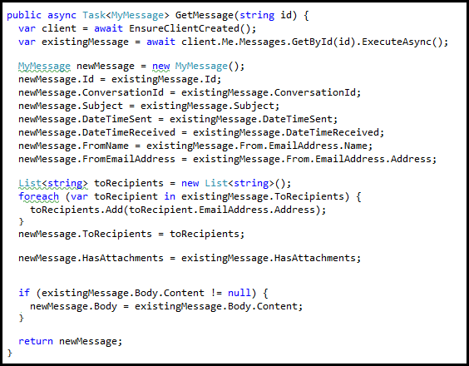
Retrieving Messages

Slide 19
demo
Creating an MVC Project that uses Connected Services

Slide 20
Paging Support

Slide 21
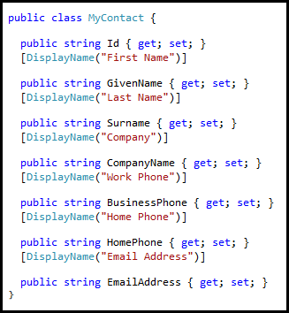
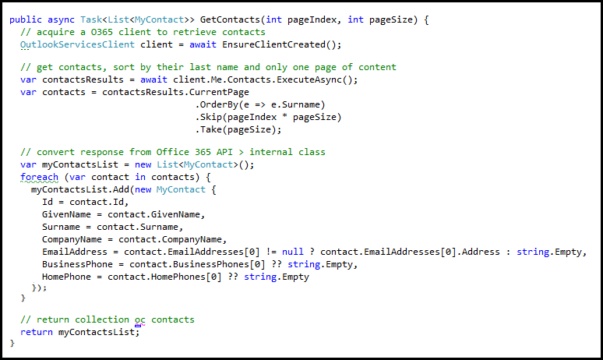
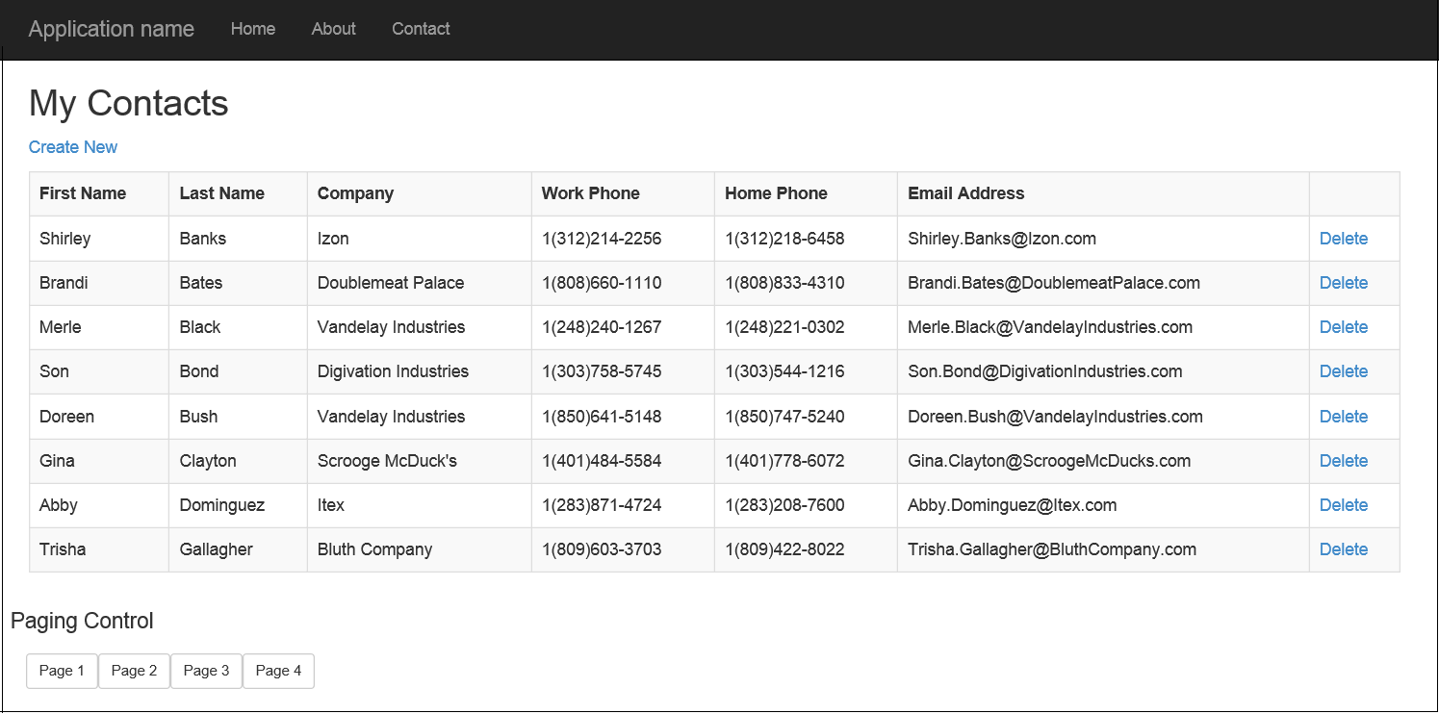
Paging with the Office 365 APIs
Limit the number of items returned by using the Take() and Skip() prior to ExecuteAsync()
Paging buttons call GetContacts which skips over the specified number of contacts to present the next page

Slide 22
demo
Examining Paging Support with ExchangeClient

Slide 23
CRUD Support

Slide 24
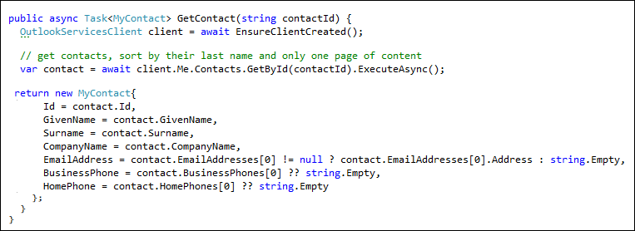

Getting and Deleting a Specific Contact
Contact retrieved by calling GetById()
Contact deleted by calling DeleteAsync() on Contact object

Slide 25
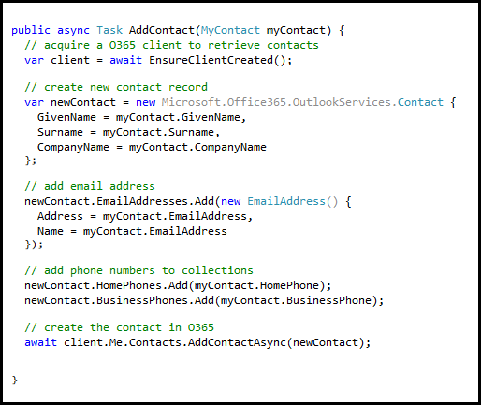
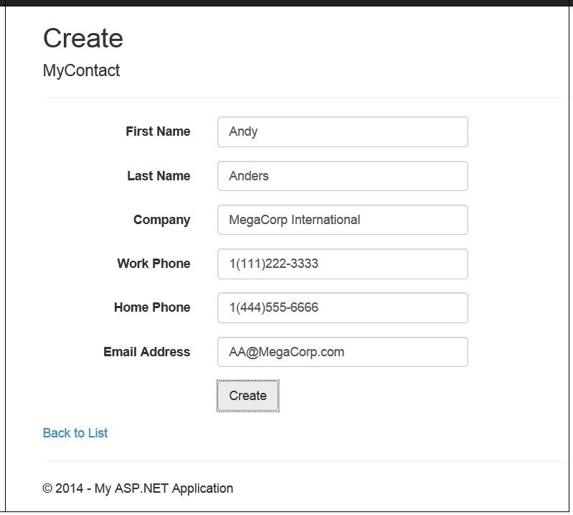
Adding a Contact
Call AddContactAsync() on Contacts collection

Slide 26
demo
Update operations with the EXCHANGEClient

Slide 27
Exchange Operations with REST

Slide 28
Office 365 Exchange REST APIs
https://outlook.office365.com/api/v1.0/me/rootFolder
https://outlook.office365.com/api/v1.0/me/messages
https://outlook.office365.com/api/v1.0/me/folders/<folder_id>/messages
https://outlook.office365.com/api/v1.0/me/folders/drafts
https://outlook.office365.com/api/v1.0/me/folders/sentitems
https://outlook.office365.com/api/v1.0/me/folders/deleteditems
https://outlook.office365.com/api/v1.0/me/events
https://outlook.office365.com/api/v1.0/me/events(<event_id>)
https://outlook.office365.com/api/v1.0/me/calendar
https://outlook.office365.com/api/v1.0/me/calendar/events
https://outlook.office365.com/api/v1.0/me/calendars(<calendar_id>)/events
https://outlook.office365.com/api/v1.0/me/contacts
https://outlook.office365.com/api/v1.0/me/contacts(<contact_id>)

Slide 29
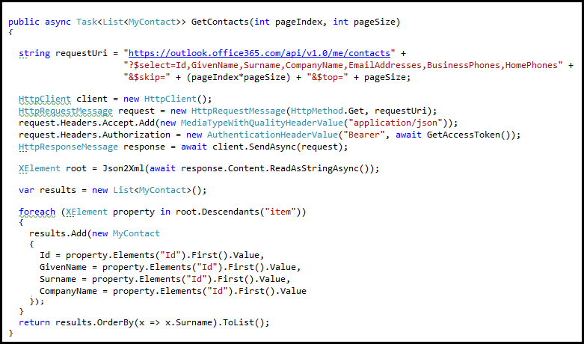
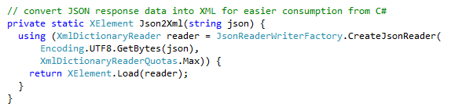
Reading Contacts using REST
Send GET request to Contacts endpoint
Office 365 Exchange API only returns JSON responses
Paging is accomplished using $skip and $top
Notes:
No support for $skip and $orderby so paging is post-query

Slide 30
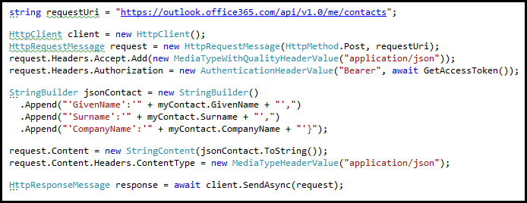
Adding a new Contact
POST to Add endpoint
Provide minimum of @data.type and GivenName property

Slide 31
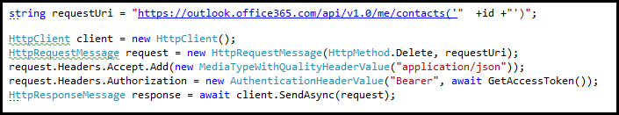
Deleting a Contact
DELETE operation targeting me/contacts(Id)

Slide 32
demo
Exchange Operations using the Office 365 REST APIs

Slide 33
Summary
Overview
Connected Services
Paging Support
CRUD Support
Exchange Operations using REST

Slide 34
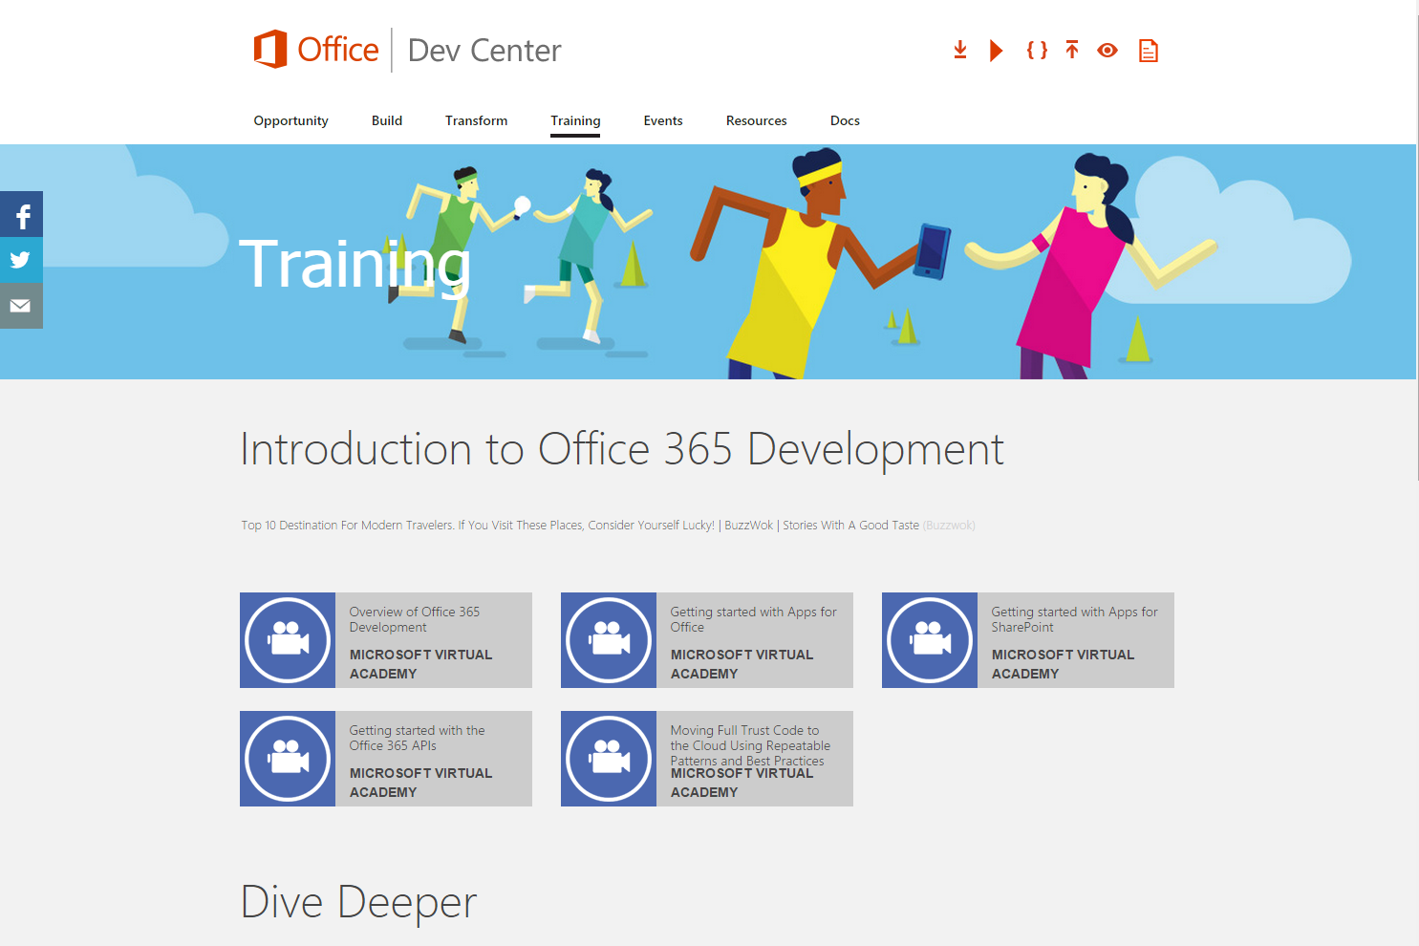
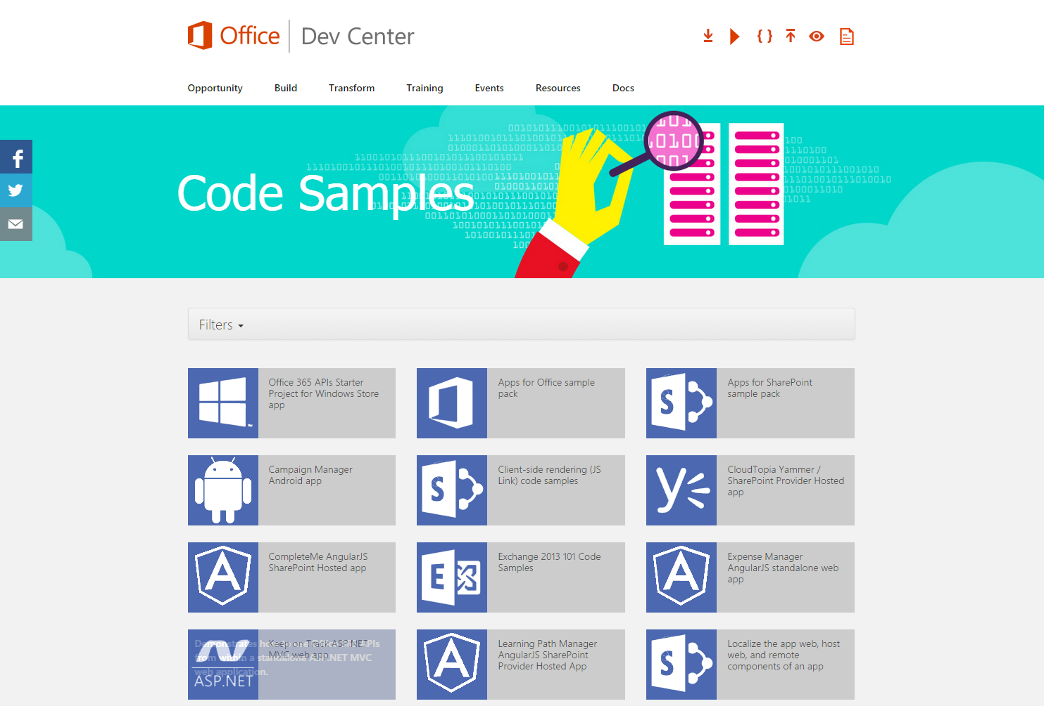
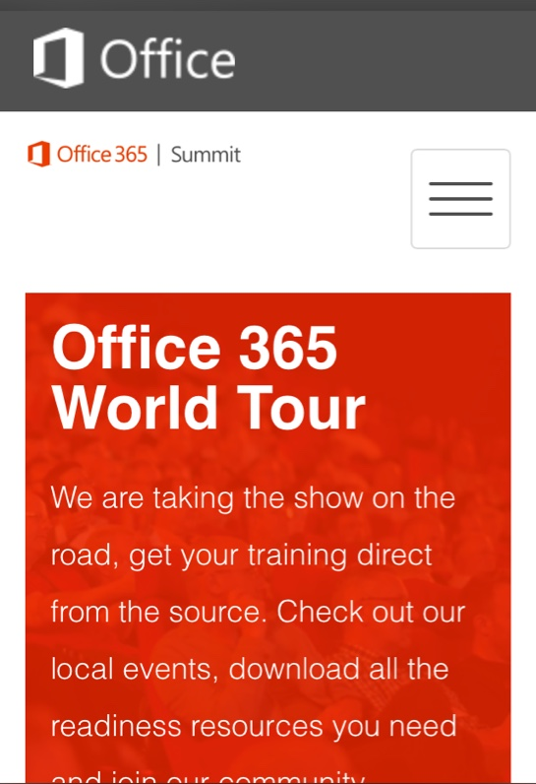
dev.office.com
Sign up
http://dev.office.com/getting-started
Explore
http://apisandbox.msdn.microsoft.com
Get trained http://dev.office.com/training

Slide 35


Feedback
Office 365 Network Share you best practices and join conversations https://www.yammer.com/itpronetwork
Stackoverflow Ask deep technical questions to a world-wide set of developers
http://stackoverflow.com/questions/tagged/ms-office
UserVoice Provide suggestions of what you want in future versions
http://officespdev.uservoice.com/

Slide 36

© 2014 Microsoft Corporation. All rights reserved. Microsoft, Windows, and other product names are or may be registered trademarks and/or trademarks in the U.S. and/or other countries.
The information herein is for informational purposes only and represents the current view of Microsoft Corporation as of the date of this presentation. Because Microsoft must respond to changing market conditions, it should not be interpreted to be a commitment on the part of Microsoft, and Microsoft cannot guarantee the accuracy of any information provided after the date of this presentation. MICROSOFT MAKES NO WARRANTIES, EXPRESS, IMPLIED OR STATUTORY, AS TO THE INFORMATION IN THIS PRESENTATION.

